Slide 1


BRP + MOSIP Integration
Beneficiary Registration Portal
James Simbi
Sparc Systems Limited

Slide 2
Who are we
Multinational IT Company
Offices in Malawi, Zambia and Rwanda
Established in 2013 to bring the gap on high-end enterprise IT

Slide 3
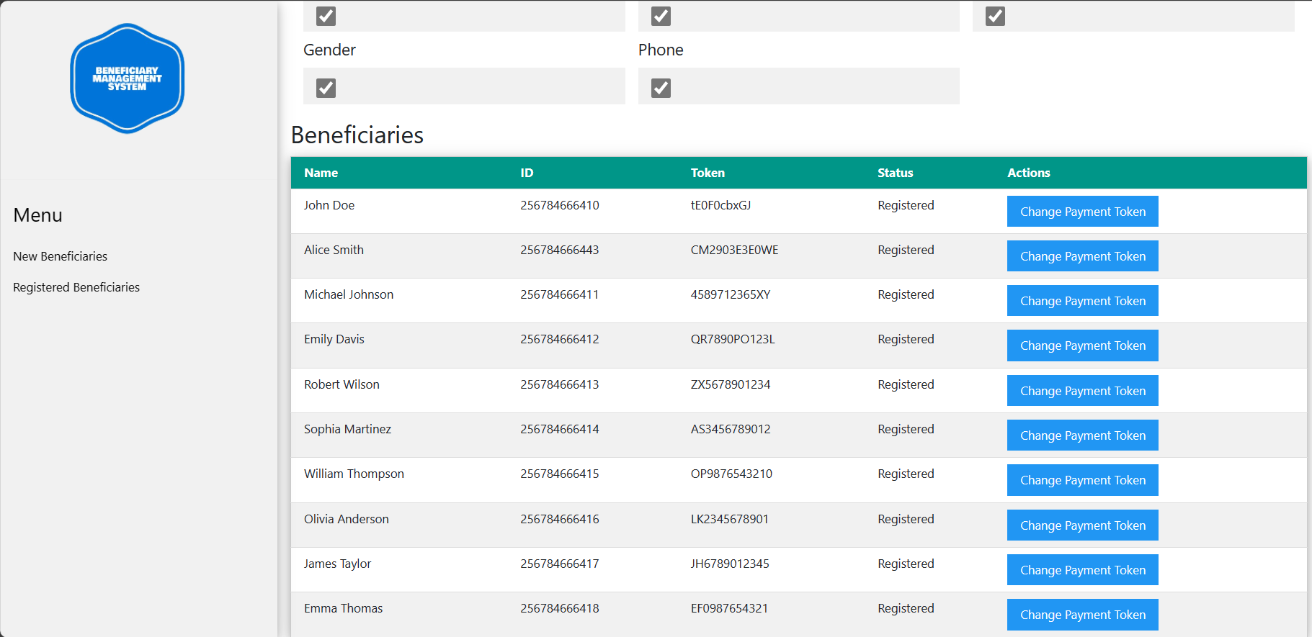
What is BRP?
- BRP (Beneficiary Registration Portal) integrates with Mojaloop.
- Enables seamless association of accounts for transactions.
Developer
Sparc Systems Limited
Technology Support
INFITX
Notes:
Welcome to our presentation on the Beneficiary Registration Portal integrated with a Mojaloop using the OpenID Connect flow. In today's rapidly evolving digital landscape, seamless and secure user authentication and authorization are paramount. Our solution leverages OpenID Connect, a standard protocol for user auth
- Utilizes OpenID Connect for secure authentication.
entication, to enhance the registration process and streamline payments within the Mojaloop ecosystem.

Slide 4
Cont.d…
- Streamlines payments within the Mojaloop ecosystem by reacting a token that is associated with the user accounts to be used during payment transactions.
Developer
Sparc Systems Limited
Technology Support
INFITX
Notes:
Welcome to our presentation on the Beneficiary Registration Portal integrated with a Mojaloop using the OpenID Connect flow. In today's rapidly evolving digital landscape, seamless and secure user authentication and authorization are paramount. Our solution leverages OpenID Connect, a standard protocol for user auth
- Utilizes OpenID Connect for secure authentication.
entication, to enhance the registration process and streamline payments within the Mojaloop ecosystem.

Slide 5
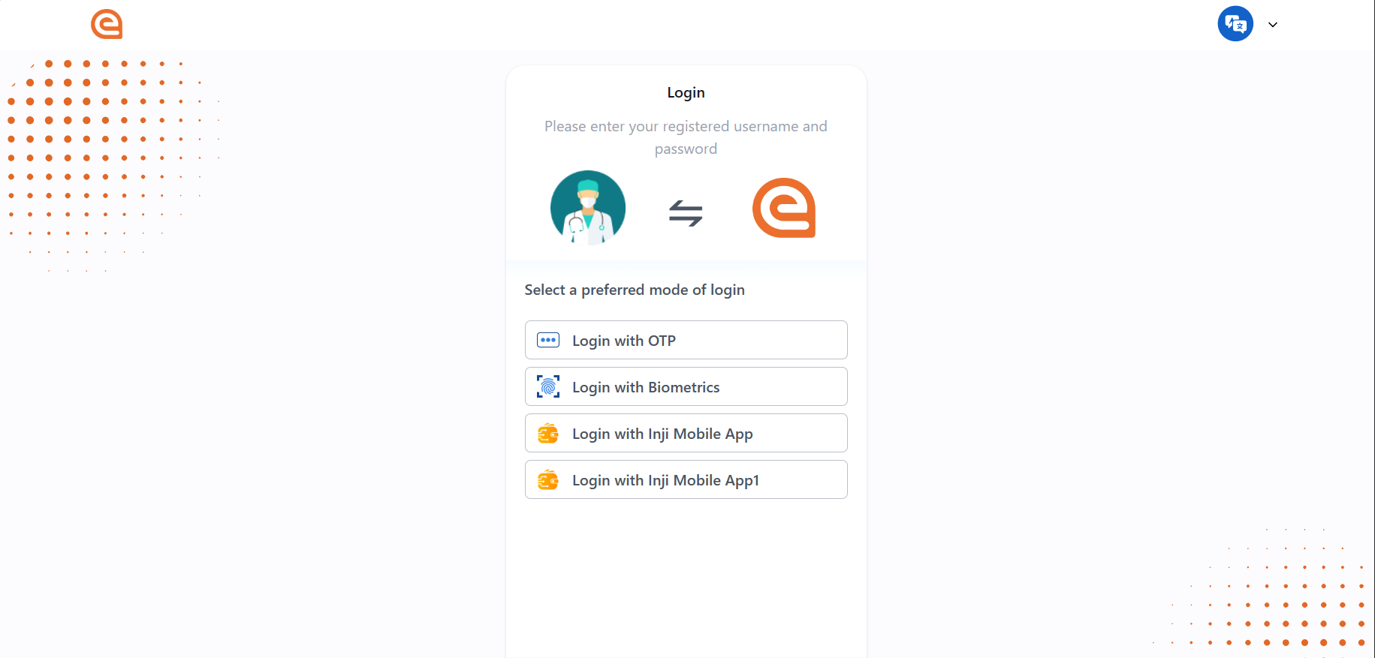
Cont.d...
- Enhances user authentication using MOSIP (Modular Open Source Identity Platform).
Developer
Sparc Systems Limited
Technology Support
INFITX
Notes:
Welcome to our presentation on the Beneficiary Registration Portal integrated with a Mojaloop using the OpenID Connect flow. In today's rapidly evolving digital landscape, seamless and secure user authentication and authorization are paramount. Our solution leverages OpenID Connect, a standard protocol for user authentication, to enhance the registration process and streamline payments within the Mojaloop ecosystem.

Slide 6




BENEFITS
Effortless Integration
MFS
MFIs
Enhanced Security
Streamlined Payment Processing
Data Verification
Notes:
- Enhanced Security: Utilizing the OpenID Connect flow ensures robust authentication, reducing unauthorized access and fraud risks.
- Efficient Payment Processing: Successful registration generates a JWT token with the payment token, enabling swift and secure transactions through Mojaloop, enhancing efficiency.
- Seamless Integration: Integration of MOSIP (MISP) OpenID Connect redirect portals simplifies login processes while maintaining security, enhancing user experience and platform adoption.
- Flexible Data Verification: Beneficiary information verification is flexible through Mojaloop Discovery calls, allowing customizable data retrieval levels for regulatory compliance and diverse user needs.
- Adaptable DFSP Integration: A specialized adapter facilitates seamless interaction between the Mojaloop Connector and core banking systems, simplifying integration efforts for existing DFSPs and promoting scalability across the ecosystem.

Slide 7
Demo

Slide 8
Thank You!

